Slide 1
FWD Project
TOGAF 9 - Core Diagrams System Use-Case Diagram Phase C – Information Systems Architectures

Slide 2
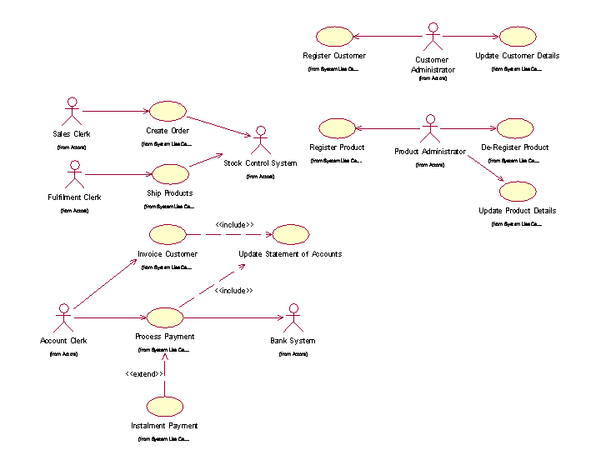
System Use Case Diagram

Slide 3
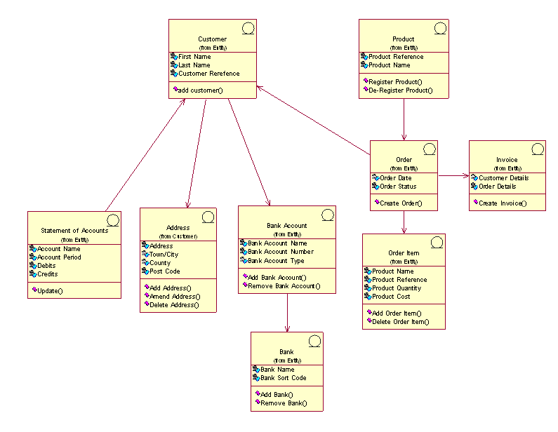
System Use Case Diagram

Slide 4
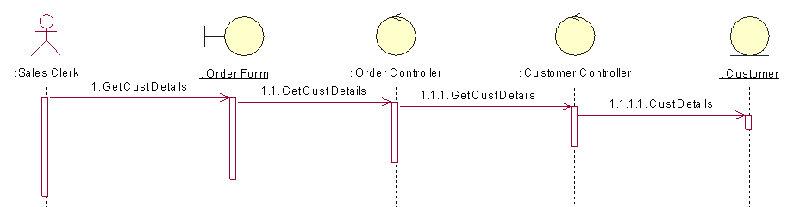
System Use Case Diagram

